Slide 1
FASE ML Bootcamp
Monday, Lecture 2
Evaluating and tuning models
Based on material from Joseph Redmon, Christopher Bishop, Polo Chau
Elements of Statistical Learning by Hastie, Tibshirani, Friedman

Slide 2
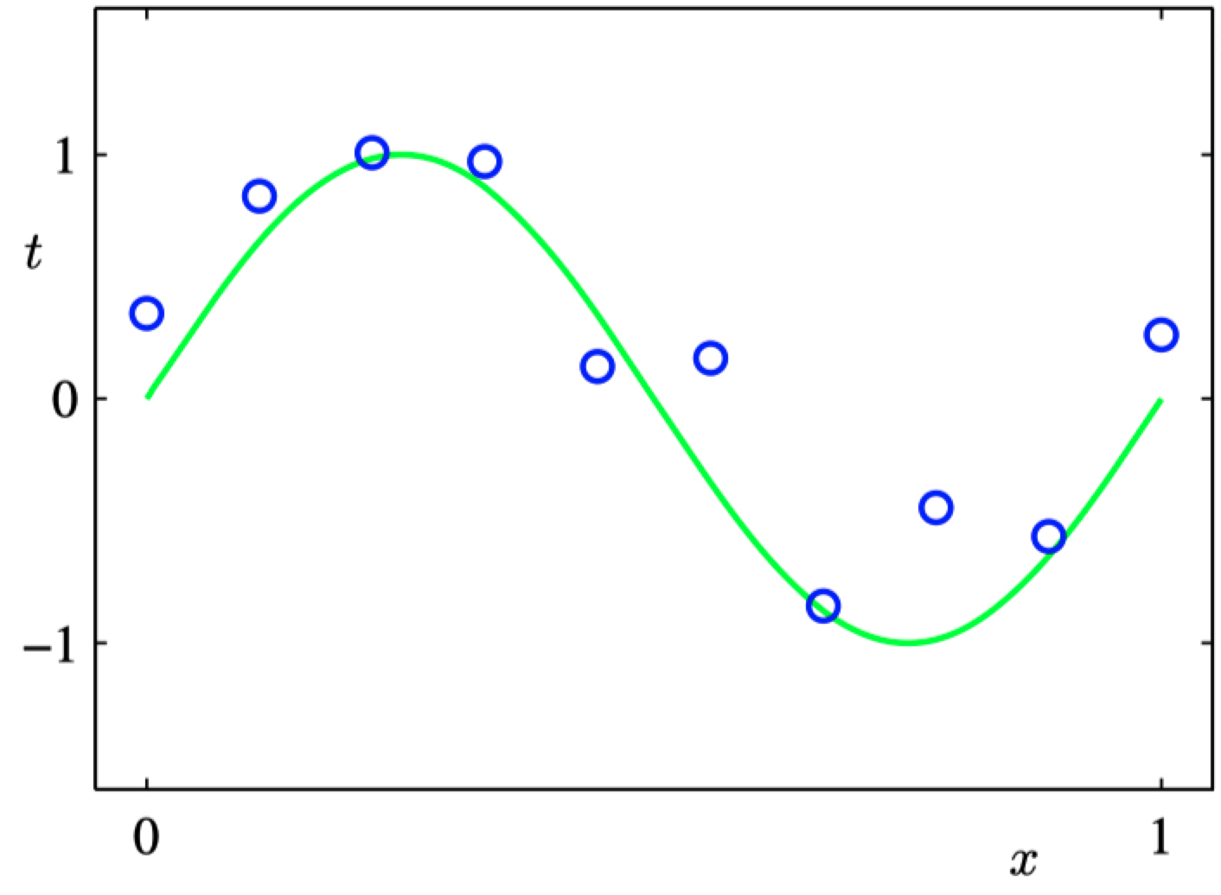
Regression
Data points (x,t) generated by adding noise to $sin⁡(2πx)$

Slide 3
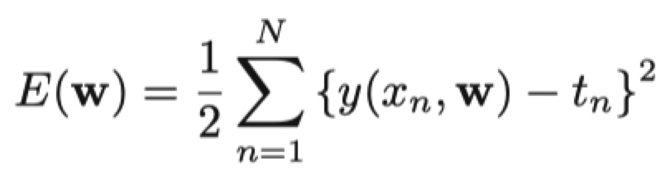
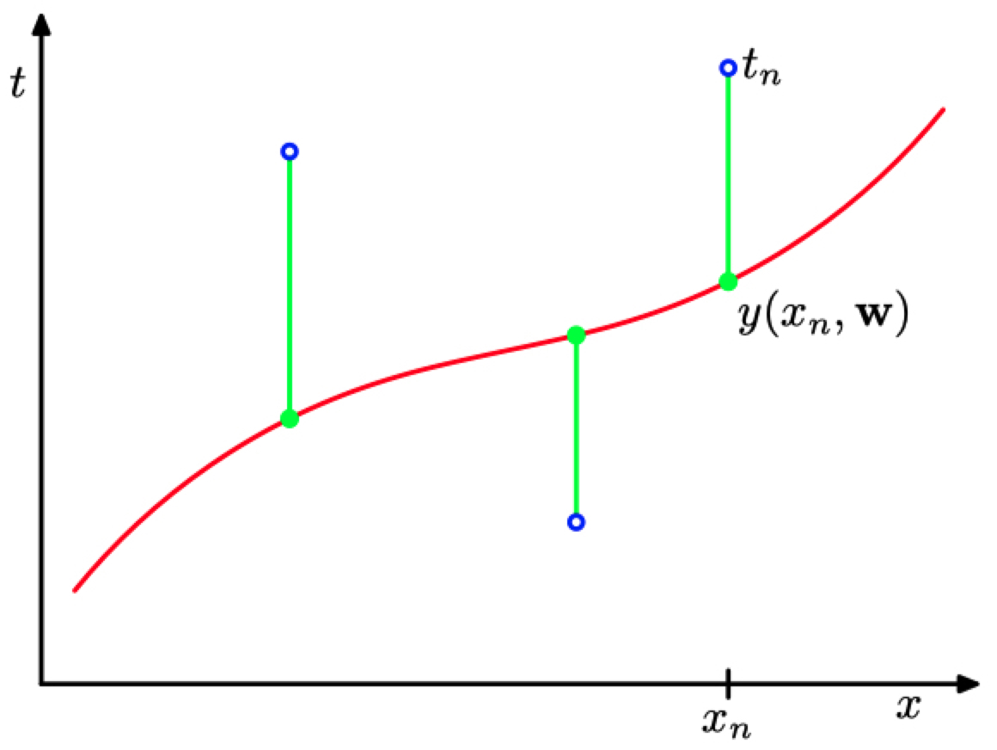
Errors in Regression
Loss Function!

Slide 4
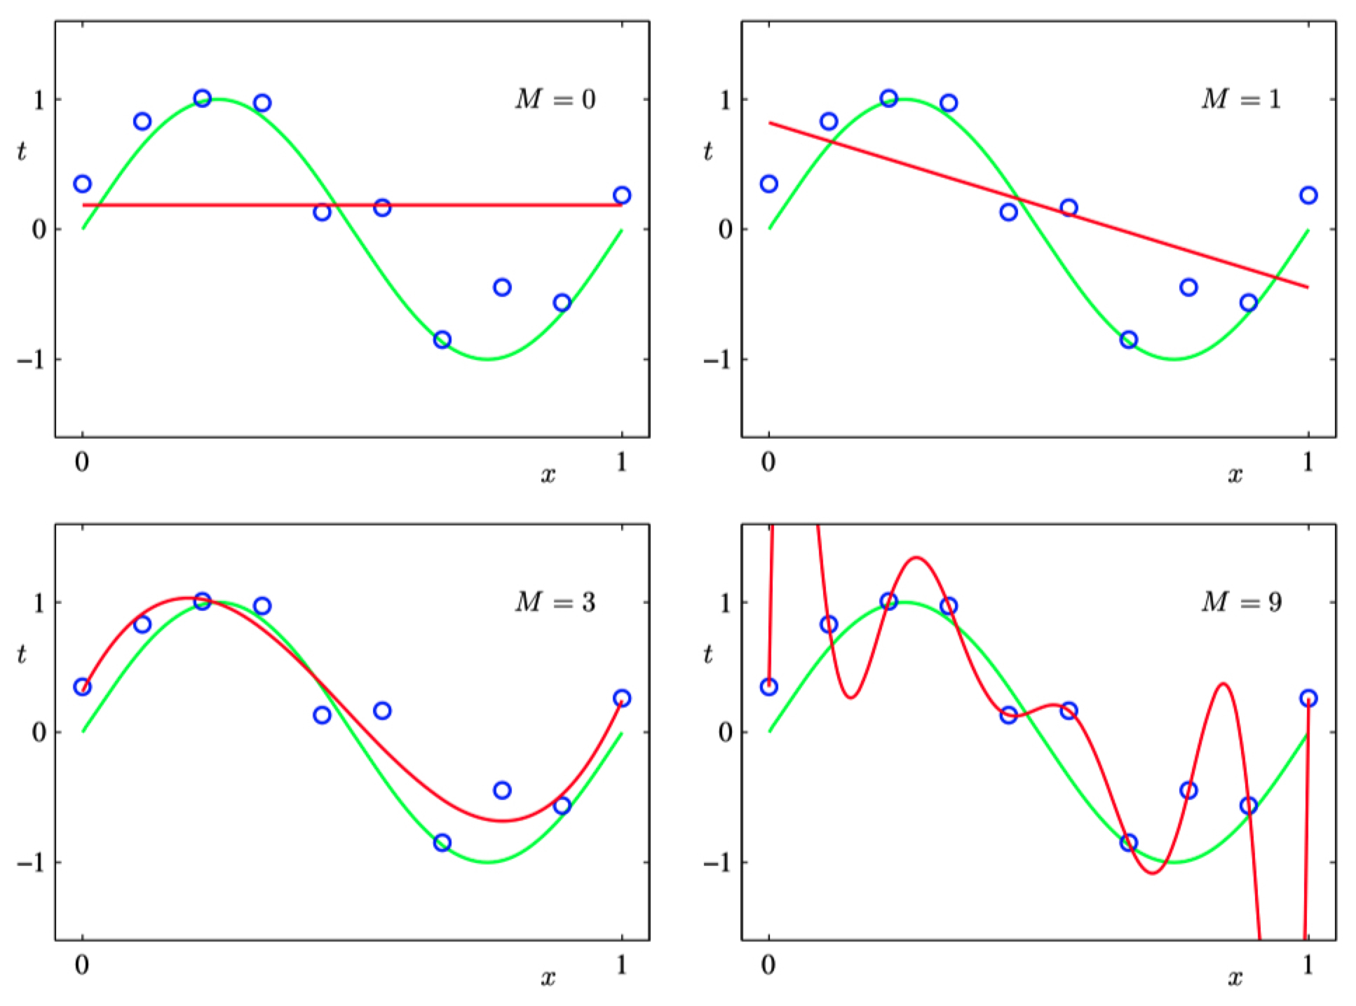

Slide 5
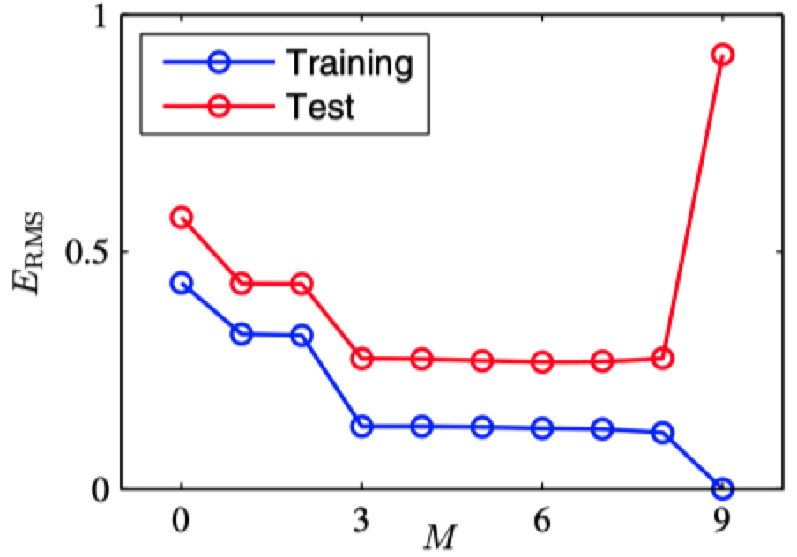
Error as a function of degree of polynomial
Error
Overfitting!
Degree of polynomial

Slide 6
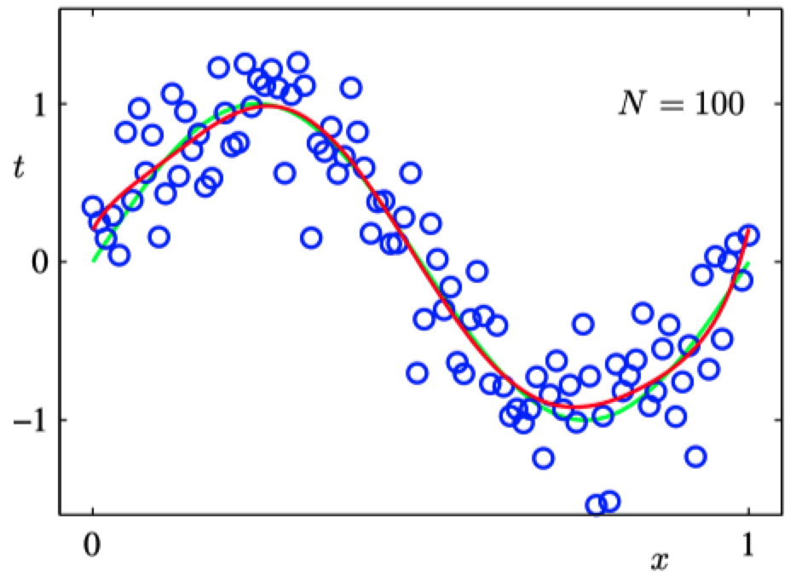
Dealing with Overfitting: (1) more data!
Degree-9 polynomial

Slide 7
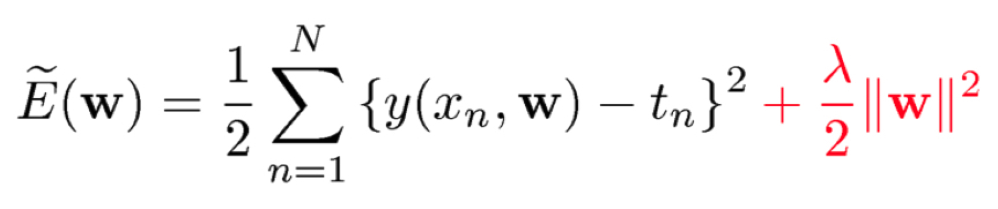


Dealing with Overfitting: (2) regularization
minimize:
Model’s squared error
Penalty on parameters

Slide 8
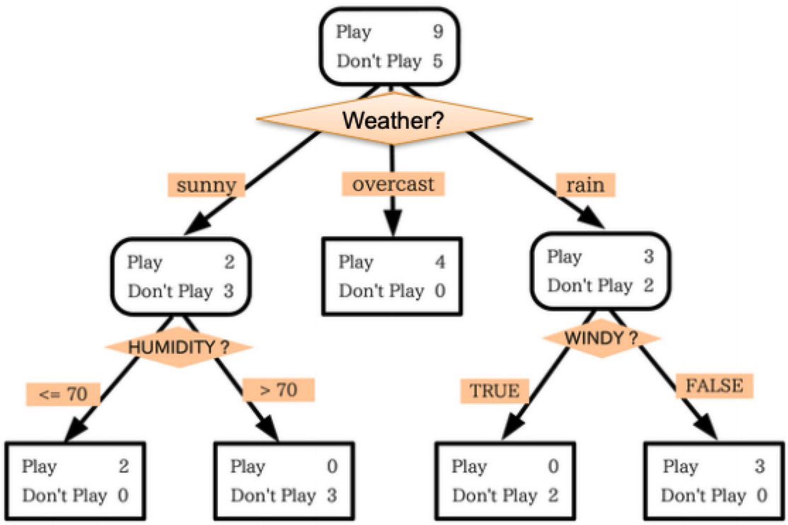

Regularization in Classification
Decision Trees
Limit the depth of the tree
Prune subtrees after training
Support Vector Machines
Built-in, tunable regularization term
Logistic Regression
Can add a tunable regularization term to MLE objective
Penalize large parameter values!

Slide 9
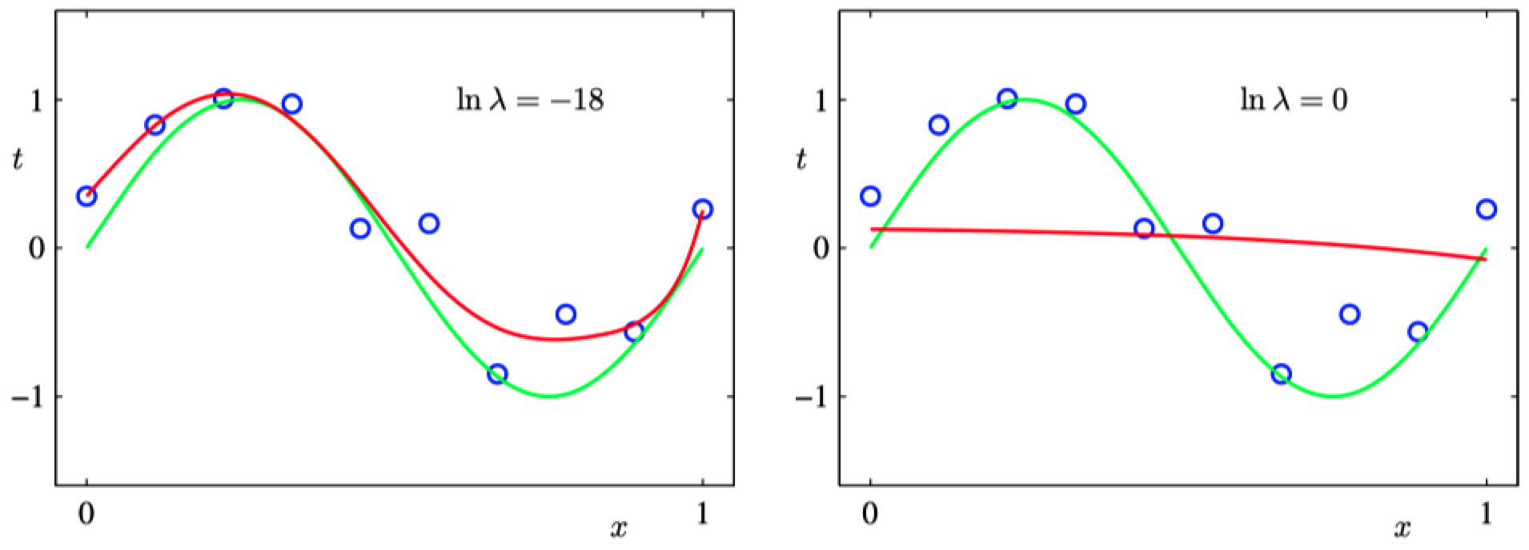


Dealing with Overfitting: (2) regularization
minimize:
$λ$ just right
$λ$ too large

Slide 10
Underfitting: model is too simplistic!
Training loss too high → Use a more complex model

Slide 11
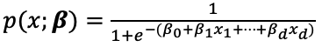
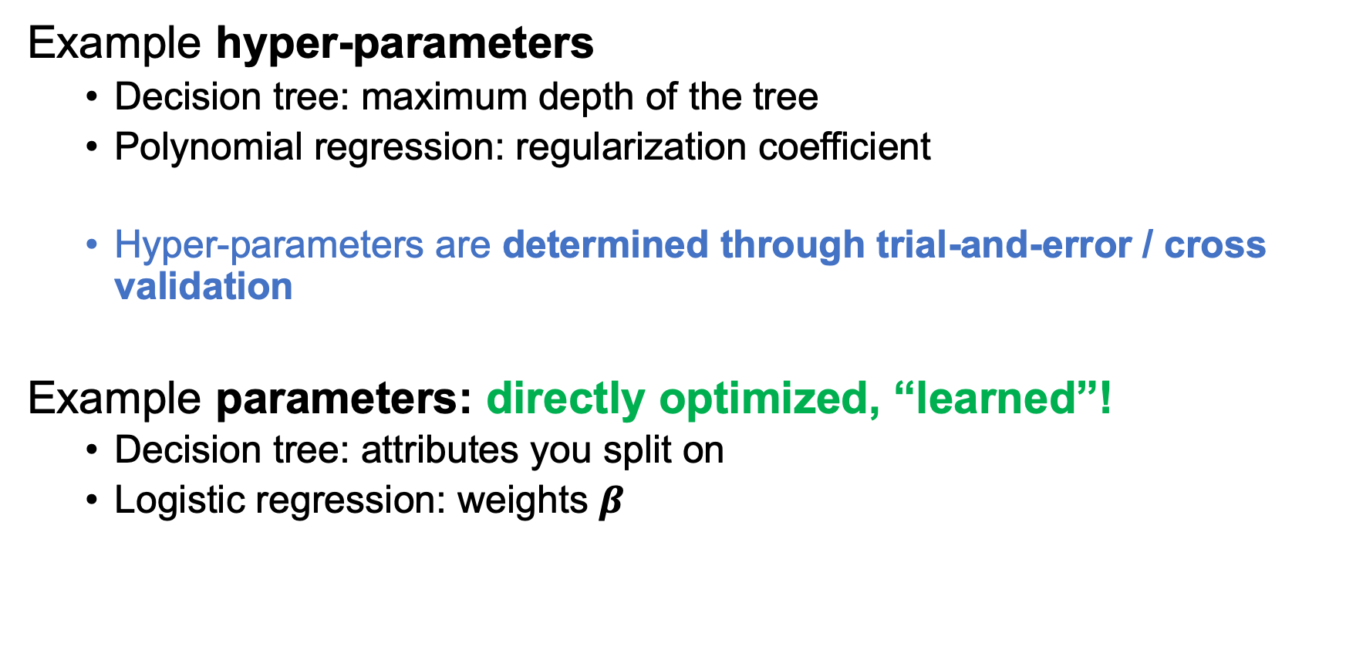
Parameters vs Hyper-parameters
Example hyper-parameters
Decision tree: maximum depth of the tree
Polynomial regression: regularization coefficient
Hyper-parameters are determined through trial-and-error / cross validation
Example parameters: directly optimized, “learned”!
Decision tree: attributes you split on
Logistic regression: weights $β$

Slide 12
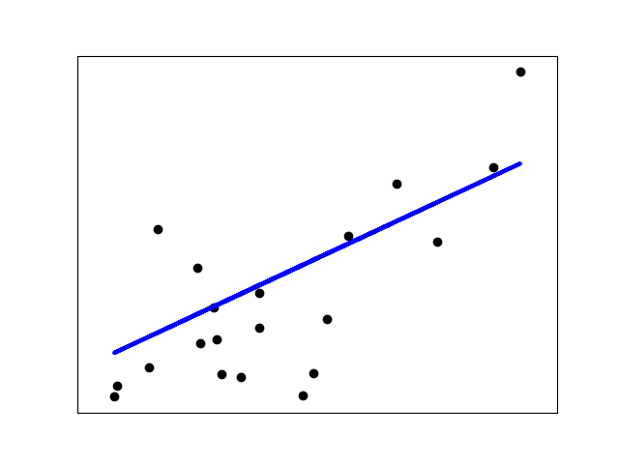
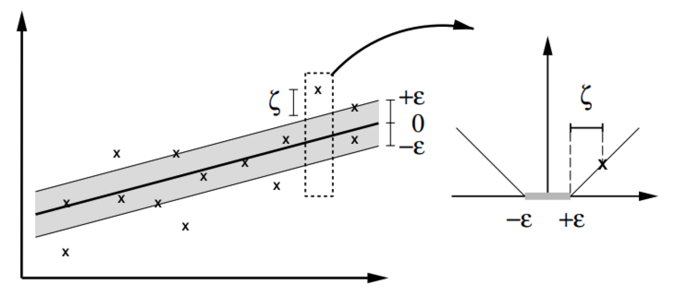
Regression
Examples:
Stock price prediction
Forecasting epidemics
Weather prediction
We will look at:
Linear Regression
Ridge Regression
LASSO
Support Vector Regression
https://medium.com/@ali_88273/regression-vs-classification-87c224350d69

Slide 13
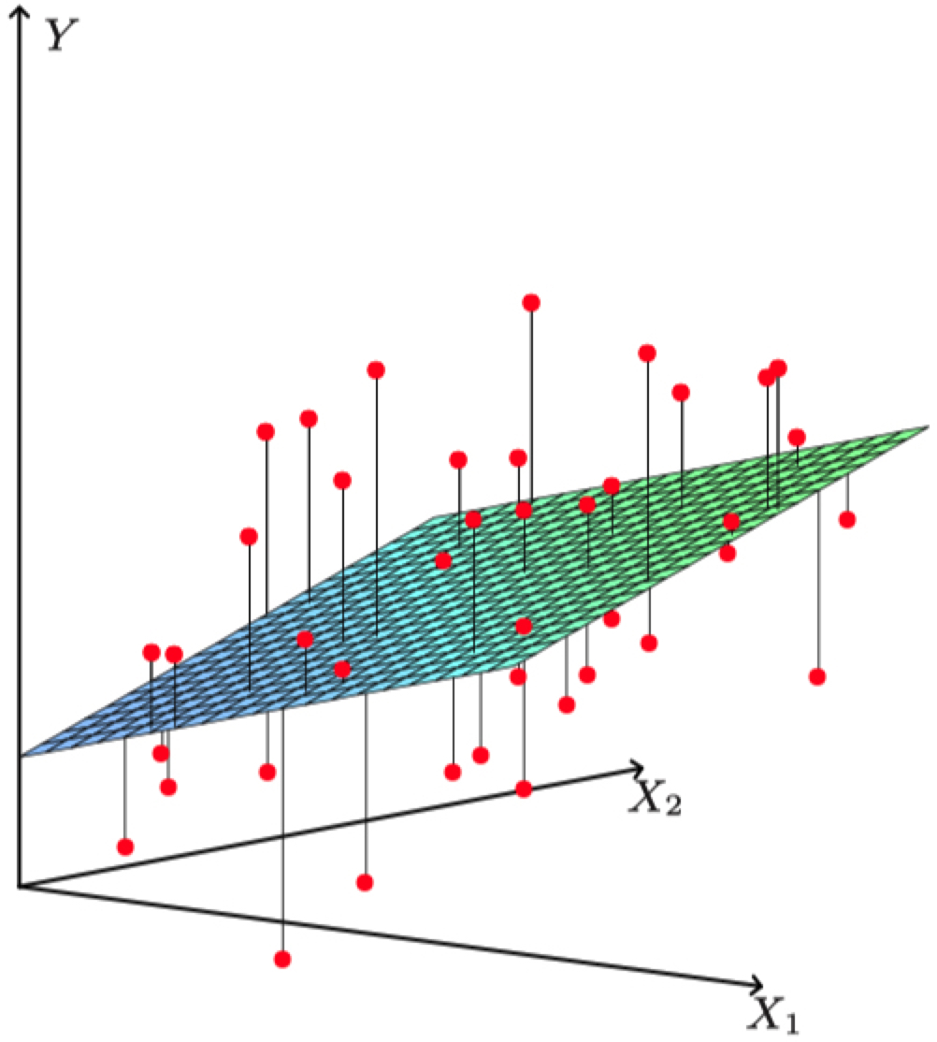
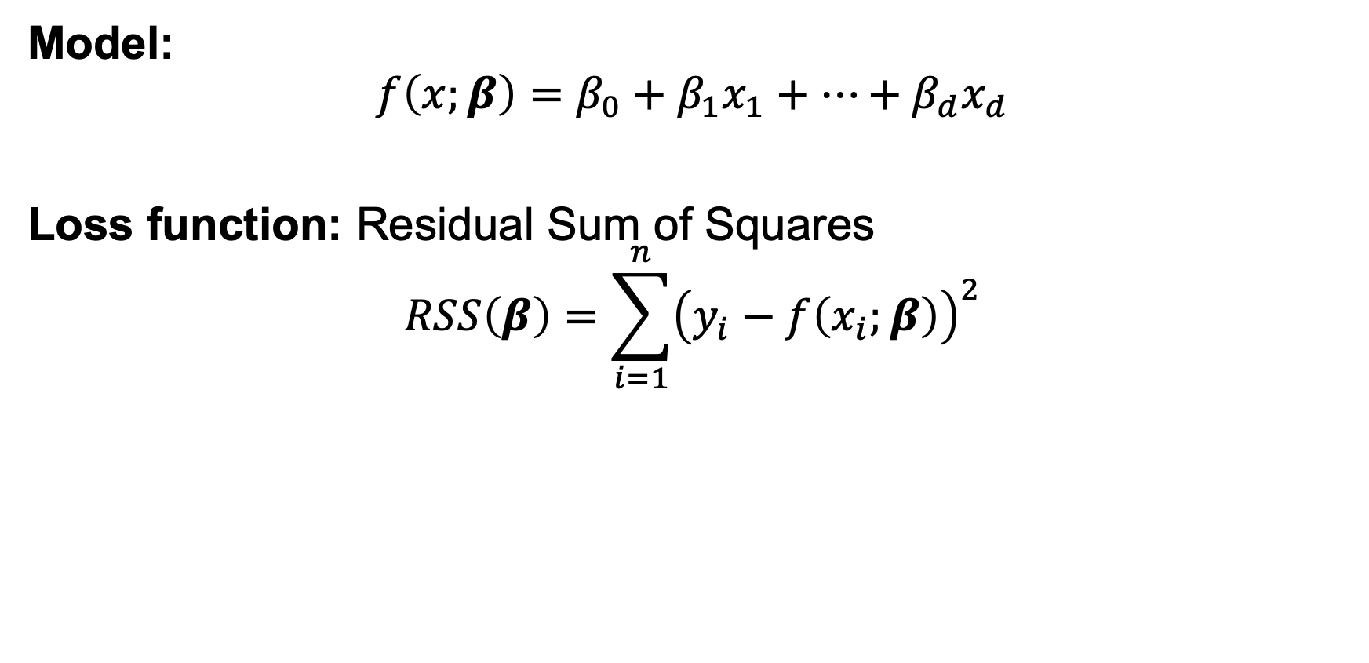
Linear Regression
Data: S = {(x_{i}, y_{i})}_{i = 1,…,n}
x_{i}: data example with d attributes
y_{i}: target of example (what you care about)
Model:
$$f\left(x;β\right)=β_{0}+β_{1}x_{1}+…+β_{d}x_{d}$$
Loss function: Residual Sum of Squares
$$RSS\left(β\right)=\sum_{i=1}^{n}{{\left(y_{i}−f\left(x_{i};β\right)\right)}^{2}}$$

Slide 14
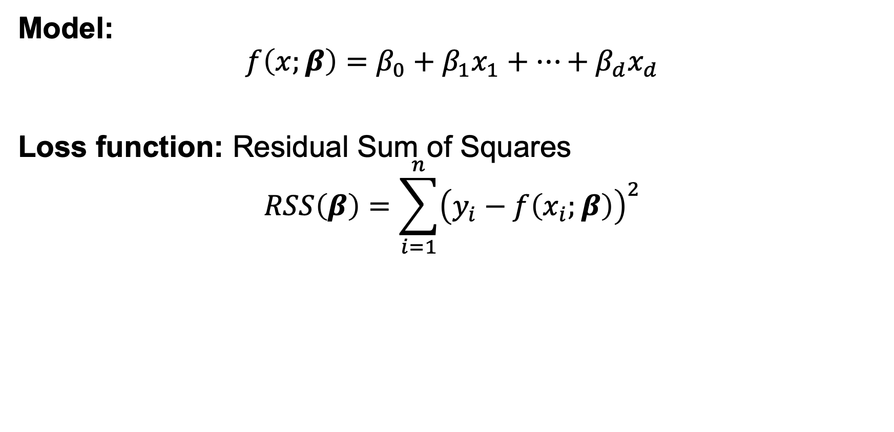
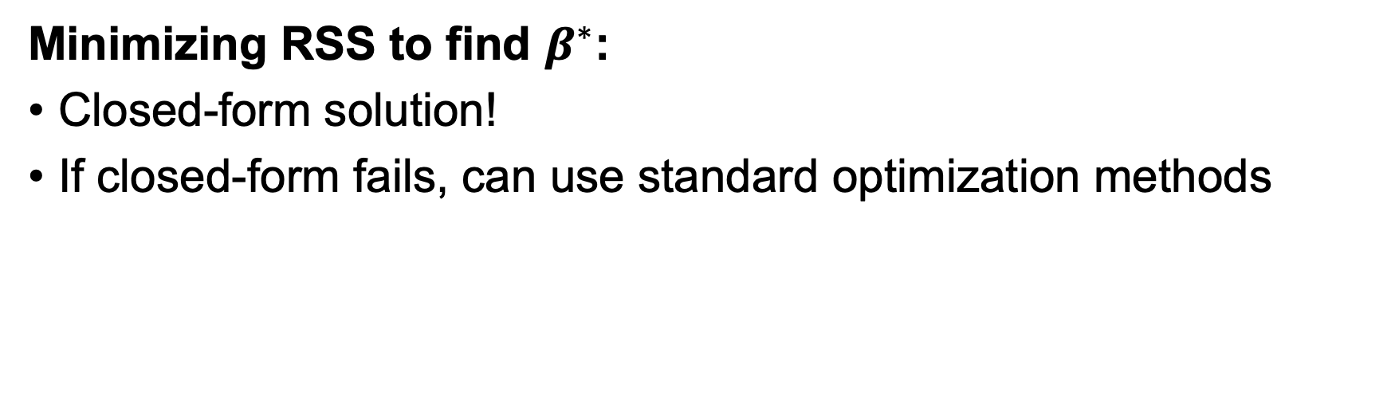
Linear Regression
Minimizing RSS to find $β^{∗}$:
Closed-form solution!
If closed-form fails, can use standard optimization methods
Model:
$$f\left(x;β\right)=β_{0}+β_{1}x_{1}+…+β_{d}x_{d}$$
Loss function: Residual Sum of Squares
$$RSS\left(β\right)=\sum_{i=1}^{n}{{\left(y_{i}−f\left(x_{i};β\right)\right)}^{2}}$$

Slide 15
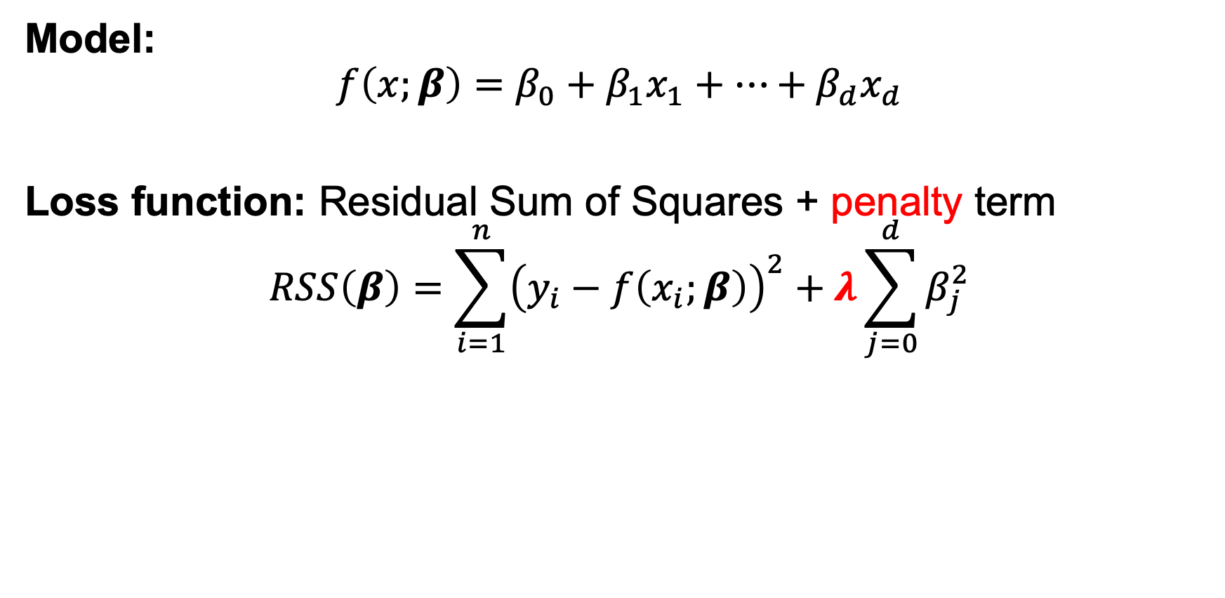
Ridge Regression
Linear Regression uses all features; model may be complicated
Ridge Regression penalizes large parameter values
Model:
$$f\left(x;β\right)=β_{0}+β_{1}x_{1}+…+β_{d}x_{d}$$
Loss function: Residual Sum of Squares + penalty term
$$RSS\left(β\right)=\sum_{i=1}^{n}{{\left(y_{i}−f\left(x_{i};β\right)\right)}^{2}}+λ\sum_{j=0}^{d}{β_{j}^{2}}$$

Slide 16
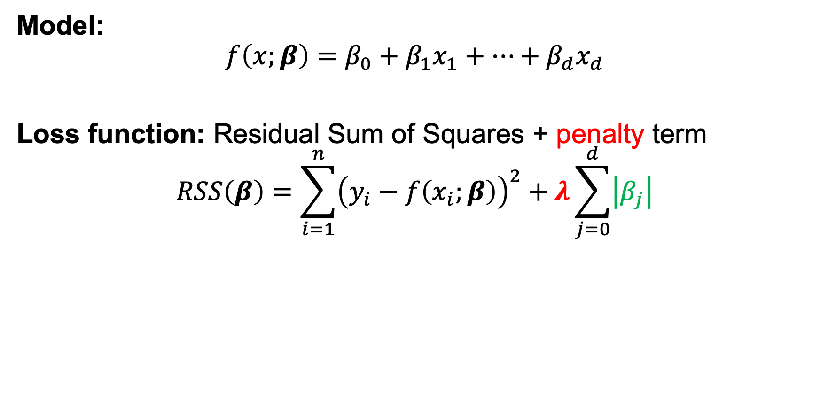
Lasso Regression
As in Ridge Regression, Lasso penalizes large parameters
Penalizes absolute instead of squared coefficient values
Zeroes out more coefficients BUT optimization is more involved
Model:
$$f\left(x;β\right)=β_{0}+β_{1}x_{1}+…+β_{d}x_{d}$$
Loss function: Residual Sum of Squares + penalty term
$$RSS\left(β\right)=\sum_{i=1}^{n}{{\left(y_{i}−f\left(x_{i};β\right)\right)}^{2}}+λ\sum_{j=0}^{d}{\left|β_{j}\right|}$$

Slide 17
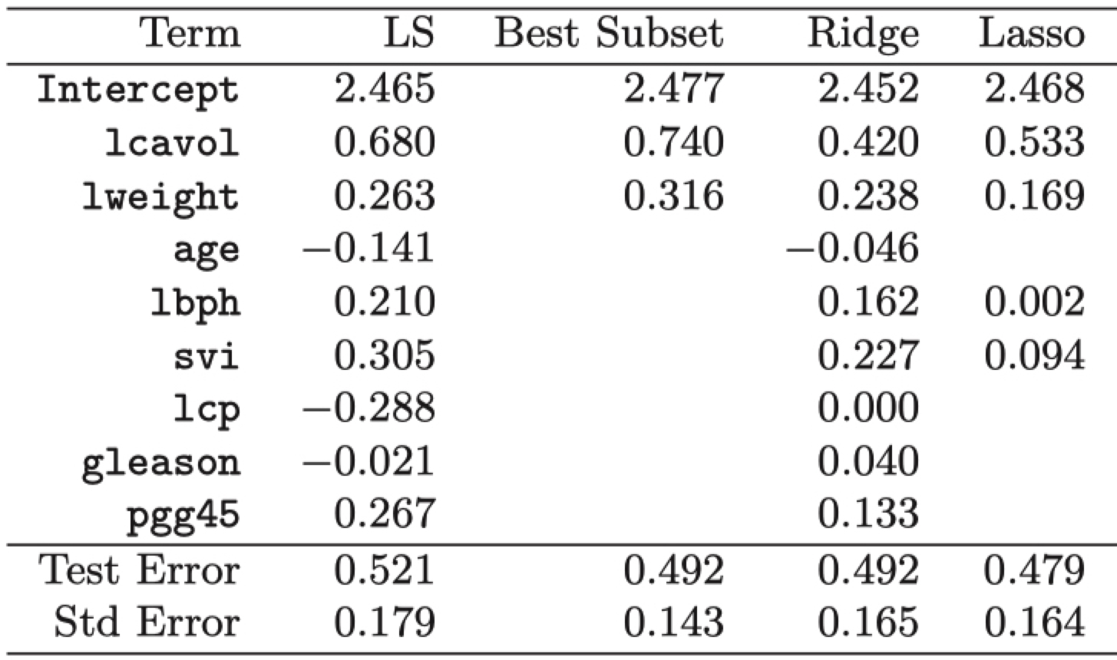
Example: Prostate Cancer
Stamey et al. (1989)
x: cancer volume, prostate weight, age, …
y: amount of prostate-specific antigen
LR

Slide 18
Bias / Variance tradeoff
Bias
Error from assumptions model makes about data
Linear model assumes data is linear, bad for data that isn’t
f(x)
x

Slide 19
Bias / Variance tradeoff
Bias
Error from assumptions model makes about data
Linear model assumes data is linear, bad for data that isn’t
Quadratic is better
f(x)
x

Slide 20
Bias / Variance tradeoff
Variance
Algorithm’s sensitivity to noise
More complex algorithms are more sensitive!
f(x)
x

Slide 21
Bias / Variance tradeoff
Variance
Algorithm’s sensitivity to noise
More complex algorithms are more sensitive!
f(x)
f(x)
x
x

Slide 22
Bias / Variance tradeoff
Variance
Algorithm’s sensitivity to noise
More complex algorithms are more sensitive!
High variance hurts generalization, overfitting
f(x)
f(x)
x
x

Slide 23
Bias / Variance tradeoff
Noise
Random variations in data
Bias
Error from assumptions model makes about data
Less complex algorithms -> more assumptions about data
Variance
Algorithm’s sensitivity to noise
More complex algorithms are more sensitive!
High variance hurts generalization
Error = Noise + Bias + Variance

Slide 24
Linear regression
f*(x) = ax + b
High bias: linear assumption
Low variance
Benefits:
Closed form solution
Fast to compute for new data
Weaknesses:
Not very powerful, assumes linear
Underfit more interesting data
f(x)
x

Slide 25
Nearest neighbor regression
f*(x) = f(x’) for nearest x’ in training set
Low bias: no assumptions about data
High variance: very sensitive to training set
Benefits:
Super easy to implement
Easy to understand
Arbitrarily powerful, esp with lots of data
Weaknesses:
Hard to scale
Prone to overfitting to noise
f(x)
x

Slide 26
ML as an Optimization problem: Regression
minimize:
Model’s squared error
Penalty on parameters

Slide 27
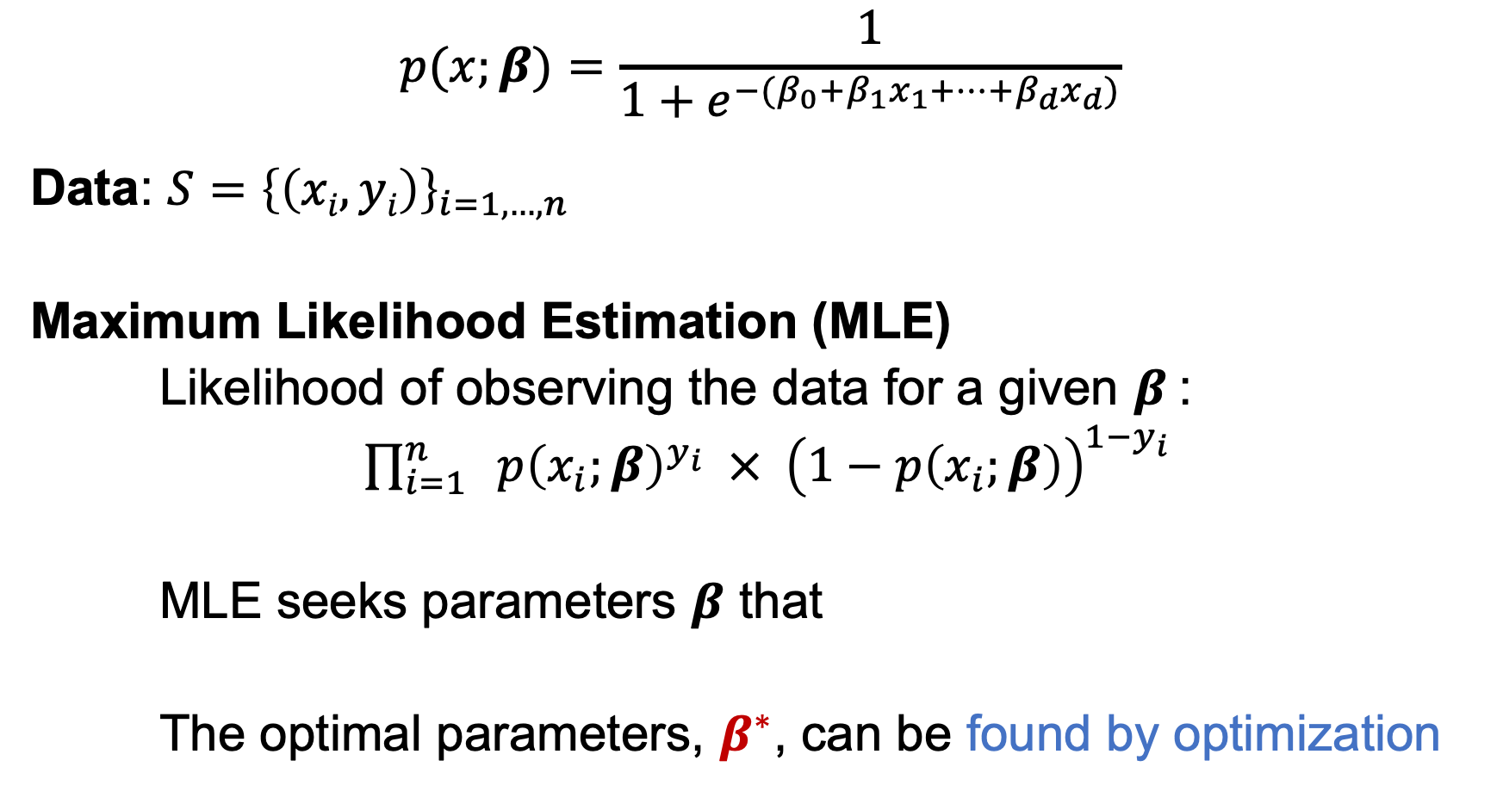
ML as an Optimization problem: Logistic Regression
$$p(x;β)=\frac{1}{1+e^{−(β_{0}+β_{1}x_{1}+…+β_{d}x_{d})}}$$
Data: $S={\left\{\left(xi, yi\right)\right\}}_{i=1,…, n}$
Maximum Likelihood Estimation (MLE)
Likelihood of observing the data for a given $β$:
$\prod_{i=1}^{n}{ p{\left(x_{i};β\right)}^{y_{i}} × {\left(1−p\left(x_{i};β\right)\right)}^{1−y_{i}}}$
MLE seeks parameters $β$ that maximize the likelihood
The optimal parameters, $β^{∗}$, can be found by optimization
x_{i}: example with d attributes (age, #pregnancies, …)
y_{i}: cervical cancer diagnosis (0 or 1)
Notes:
https://christophm.github.io/interpretable-ml-book/logistic.html

Slide 28

Convexity
For convex problems, gradient descent gets us to global minima. It’s that easy!
Graphically… which of these is convex?
Loss
w
w
w
w

Slide 29
Non-convexity
Usually no easy way to find global or local optima, harder to optimize
Loss

Slide 30
Gradient descent
For some loss function L(w), gradient ∇L(w) points towards in direction of steepest ascent.
In 1d, either points left or right

Slide 31
Gradient descent
For some loss function L(w), gradient ∇L(w) points towards in direction of steepest ascent.
In 1d, either points left or right

Slide 32
Gradient descent
For some loss function L(w), gradient ∇L(w) points towards in direction of steepest ascent.
In 1d, either points left or right

Slide 33
Gradient descent
For some loss function L(w), gradient ∇L(w) points towards in direction of steepest ascent.
In 1d, either points left or right

Slide 34
Gradient descent
For some loss function L(w), gradient ∇L(w) points towards in direction of steepest ascent.
In 1d, either points left or right
Algorithm:
Take derivative Move slightly in other direction Repeat

Slide 35
Gradient descent
For some loss function L(w), gradient ∇L(w) points towards in direction of steepest ascent.
In 1d, either points left or right
Algorithm:
Take derivative Move slightly in other direction Repeat

Slide 36
Gradient descent
Algorithm:
Take derivative Move slightly in other direction Repeat
End up at local optima

Slide 37
Gradient descent
Formally: w_{t+1}= w_{t} - η ∇L(w)
Where η is step size, how far to step relative to the gradient

Slide 38
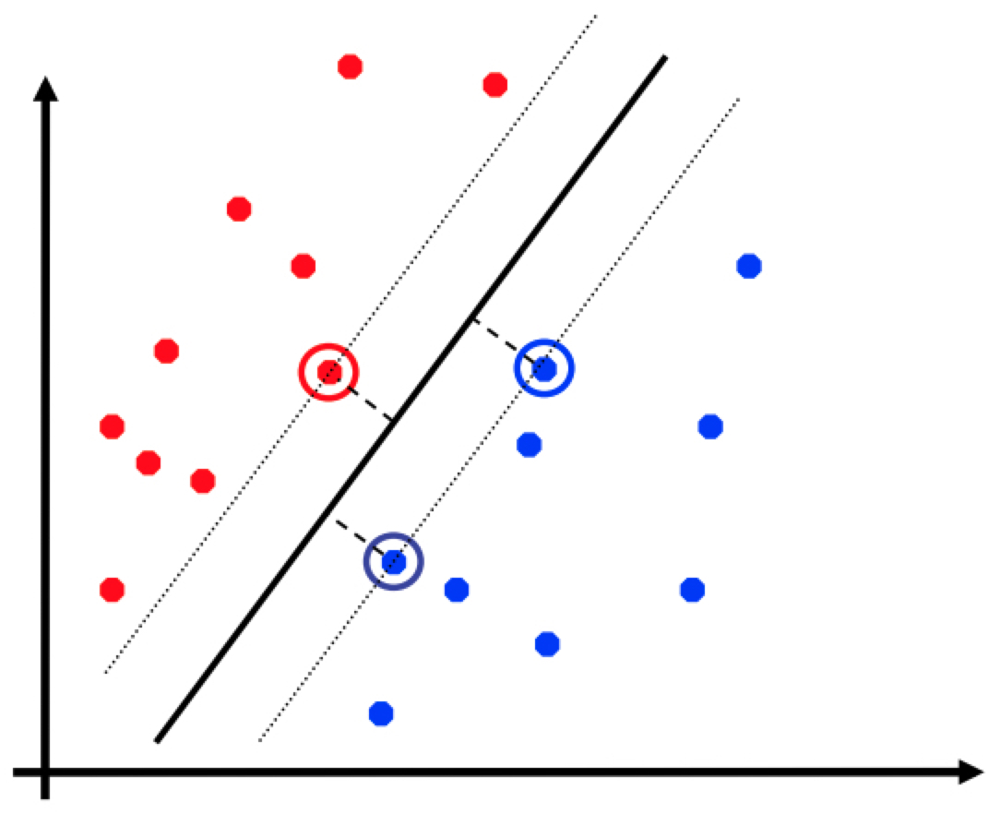
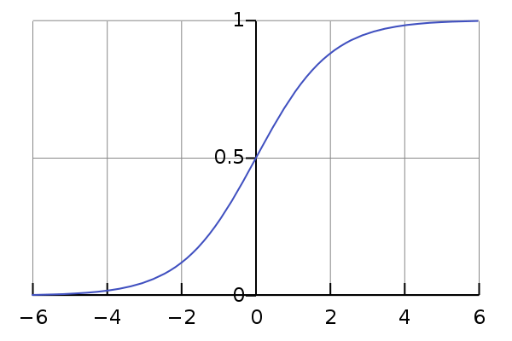
Optimization in Classification
Decision Trees
Very hard to find optimal tree (min. misclassification)
Top-down heuristic as shown in Lecture 1
Support Vector Machines
Convex optimization!
Logistic Regression
Convex optimization!

Slide 39
SVR
SVR: https://alex.smola.org/papers/2003/SmoSch03b.pdf
https://stats.stackexchange.com/a/351798

